Slide 1


Group 12
Driver & Fleet Behavior Analysis using Big Data Ecosystem
Presented by
Viyyapu, Lalit Madhav
Shruthi Kannapiran
Agalduti, Sachitanand
Akkana, Deekshitha
Jain, Nimanshu Nirmal

Slide 2

Problem Statement & Objectives
Problem Statement
ANT wants to proactively reduce insurance and compliance risk from unsafe driver behavior and operational inefficiencies. With risk factor thresholds, telematics data, and performance logs, the goal is to identify outliers, predict risk, and manage fleet health using data science.
Objectives
Detect risky driving behavior using aggregated risk metrics
Improve operational efficiency through predictive fuel and maintenance analysis
Use clustering and ML to group and flag critical driver or vehicle segments
Provide actionable dashboards for internal and insurance alerts

Slide 3
Workflow Diagram
Phase 1
Data Sources
Phase 2
Data Ingestion & Storage
Phase 3
Processing & Analysis
Phase 6
Outcome
Phase 5
Integration Points
Phase 4
Visualization using Tableau / Power BI

Slide 4
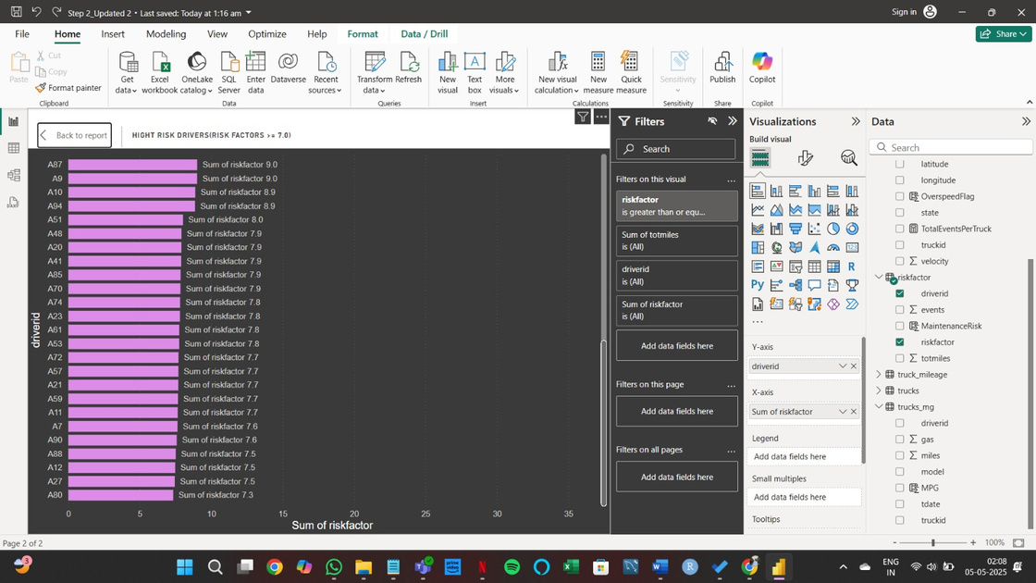
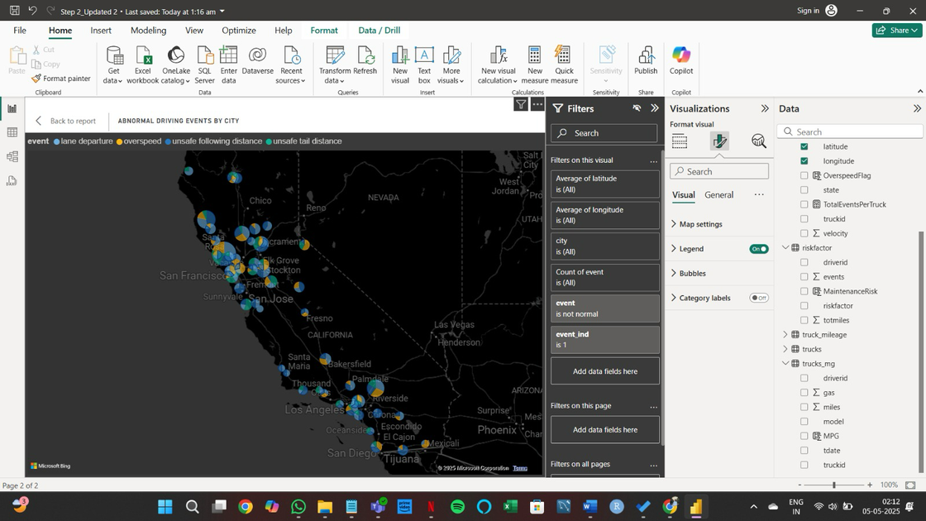
Business Questions
Question 1- Which drivers have a risk factor ≥ 7.0?
Question 2- Which cities report the highest number of abnormal
driving events, and what types of events occur most frequently in
each?
Inference- Drivers exceeding the 7.0 risk threshold
consistently exhibit high cumulative mileage and frequent adverse driving events. These patterns signal aggressive or unsafe behavior.
Inference- Geographic clustering of specific abnormal events (like harsh braking or overspeeding) reveals regional driver behavior trends. This insight supports localized training or route redesigns to reduce risk and improve efficiency.

Slide 5
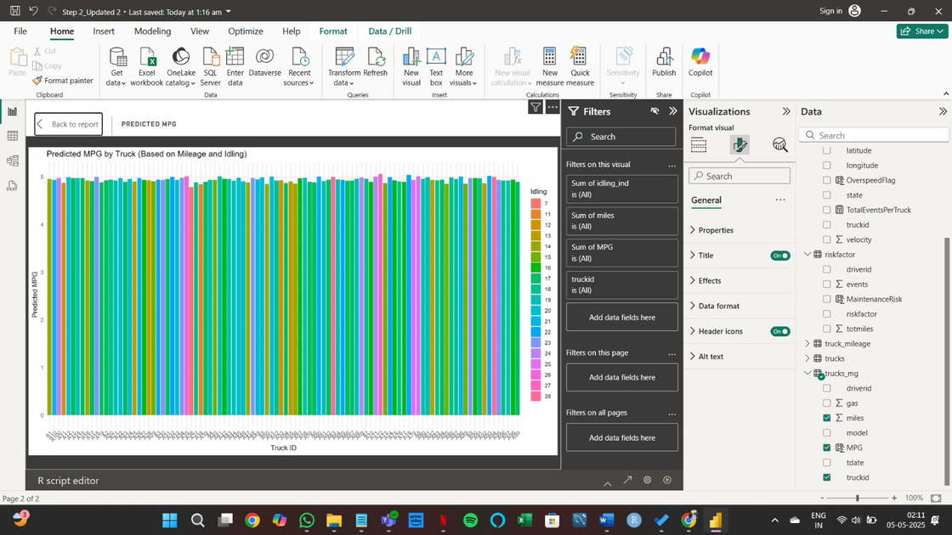
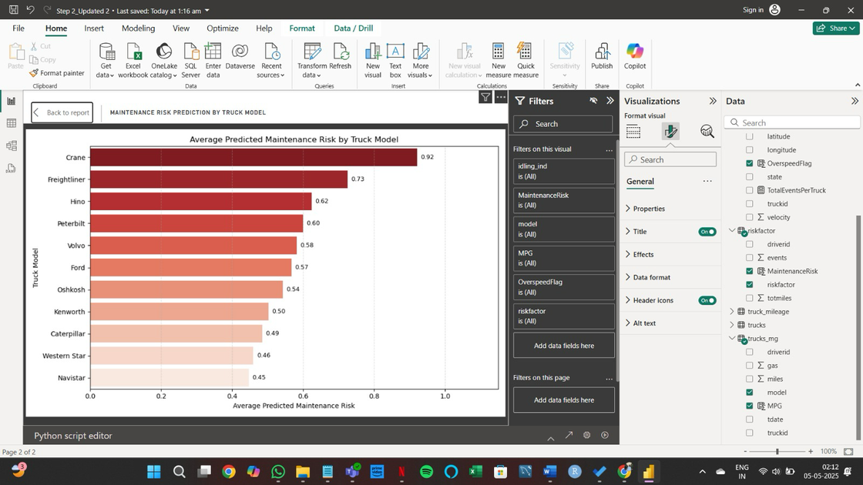
Business Questions(Integration with R and Python)
Question 3- Predicting a truck’s fuel efficiency (MPG) using its
mileage and idling behaviour?
Question 4- Which truck models are most likely to experience maintenance issues based on overspeeding, idling, and MPG behavior?
Inference- Fuel efficiency can be reliably modeled using idling time and mileage. R-based regression analysis shows that longer idle durations and excessive mileage reduce predicted MPG. This enables predictive alerts for inefficient performance and helps optimize driver scheduling and truck usage for fuel cost savings.
Inference- Truck models with high overspeed flags, poor fuel economy, and excessive idling have significantly higher predicted maintenance risk scores. Using a Random Forest model, we identified specific models that may require proactive servicing or replacement. This can prevent breakdowns and reduce repair costs through ML-based fleet maintenance planning.

Slide 6
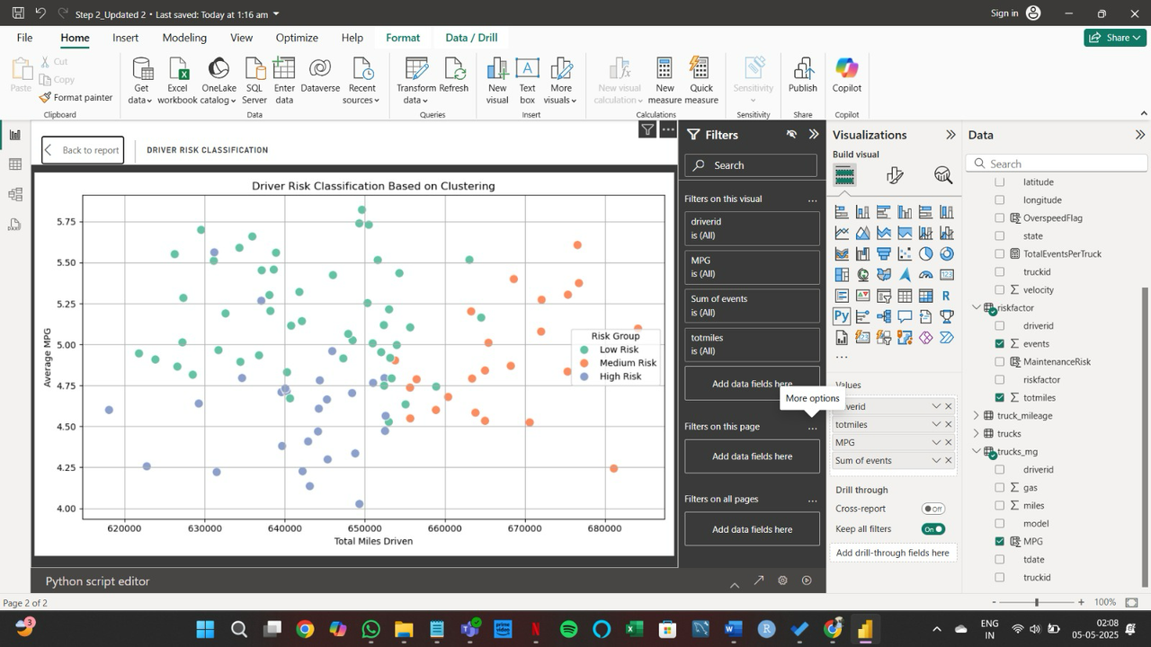
Business Questions(Integration with Python)
Question 5
Can we classify drivers into risk categories (Low, Medium, High) using clustering based on events, mileage, and fuel efficiency?
High-risk drivers have high event frequency and low MPG
Low-risk drivers drive efficiently with fewer incidents
This allows personalized safety interventions, insurance tiering, and driver recognition programs. It also provides a scalable, ML-based alternative to manual risk classification.

Slide 7
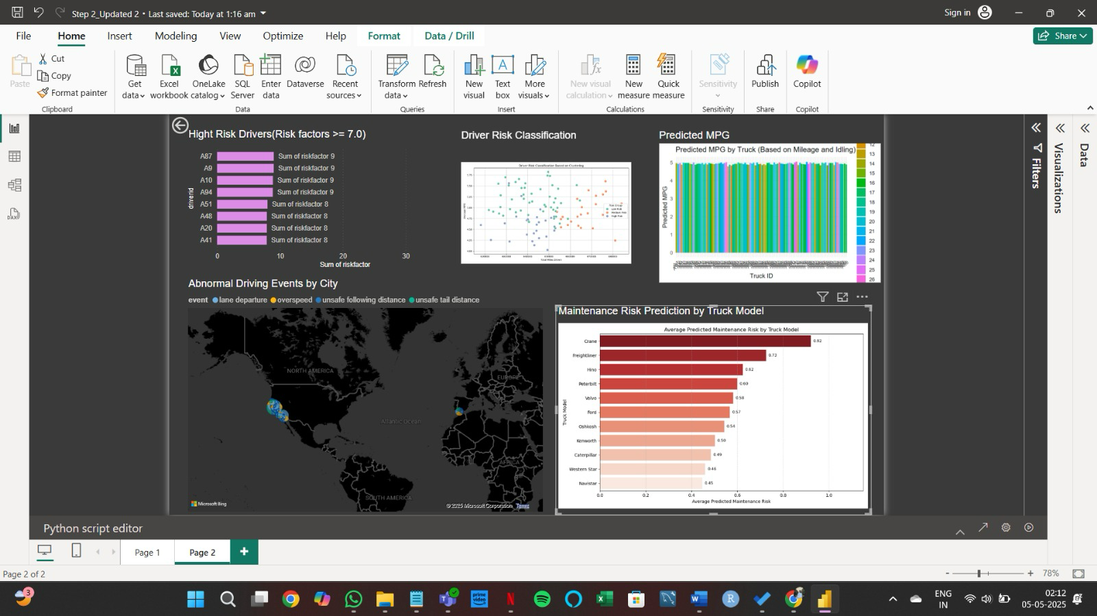
Dashboard

Slide 8

Thank You!

